Slide 1
Technology Fundamentals for Analytics
Jason Kuruzovich

Slide 2
...the purpose of the lecture is
to summarize the Semantic Web
with key concepts and
the introduction of a few advanced ideas
that will be useful to these graduating seniors
in grad school
or their careers...

Slide 3
...the purpose of the lecture is
to summarize the Semantic Web
with key concepts and
the introduction of a few advanced ideas
that will be useful to these graduating seniors
in grad school
or their careers...

Slide 4
What really matters?

Slide 5
Is this “Semantic Web” for real?

Slide 6
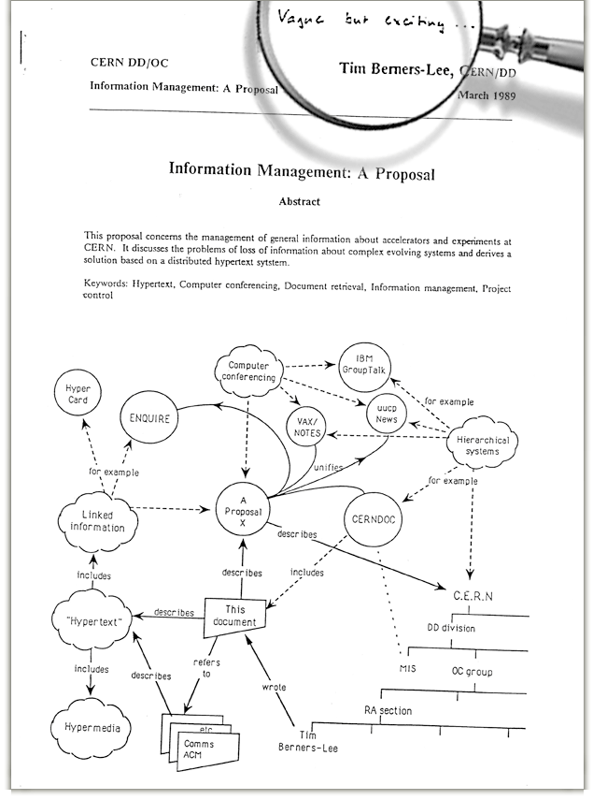
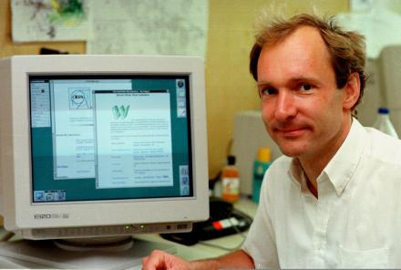
1989...

Slide 7
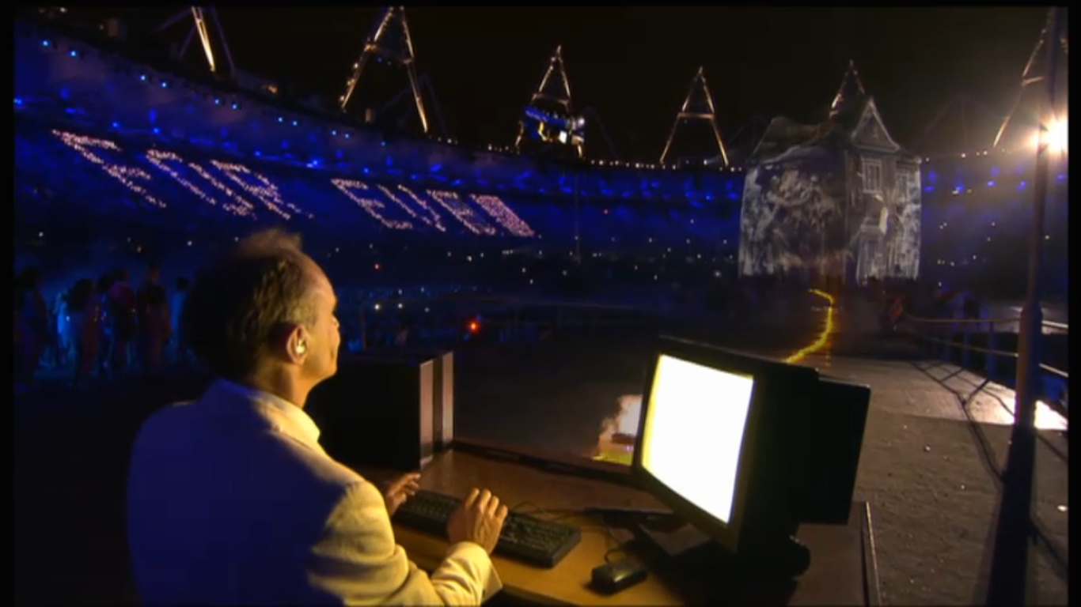
“Vague but exciting...”
1989...

Slide 8
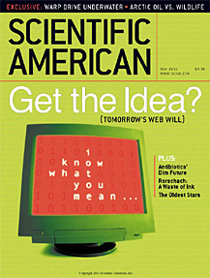
2001...

Slide 9
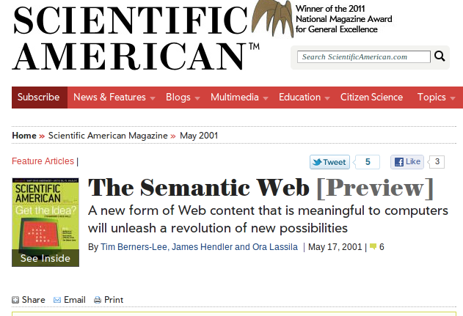
2001...

Slide 10
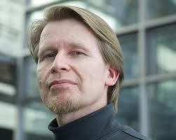
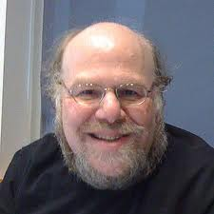
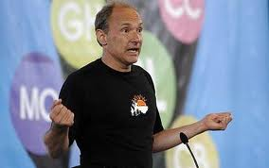
2001...

Slide 11
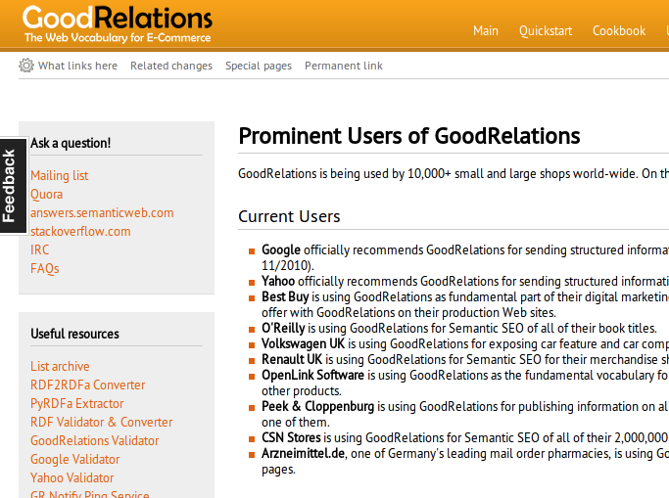
Today...

Slide 12
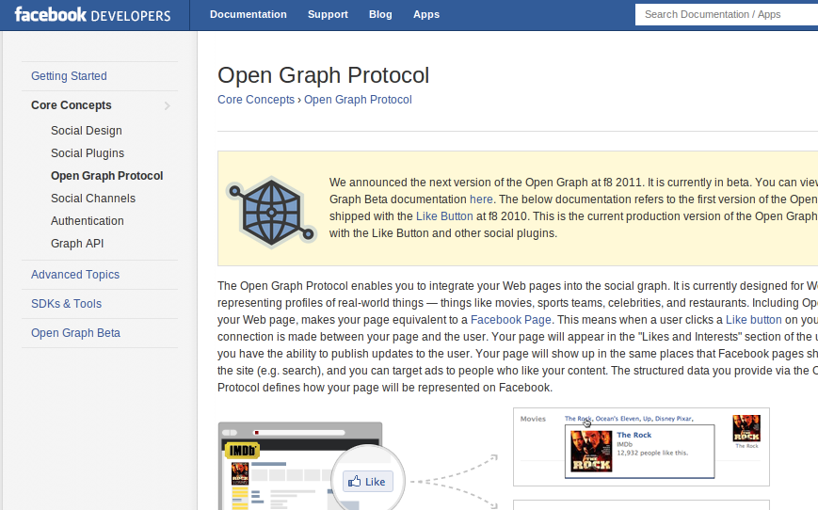
Today...

Slide 13
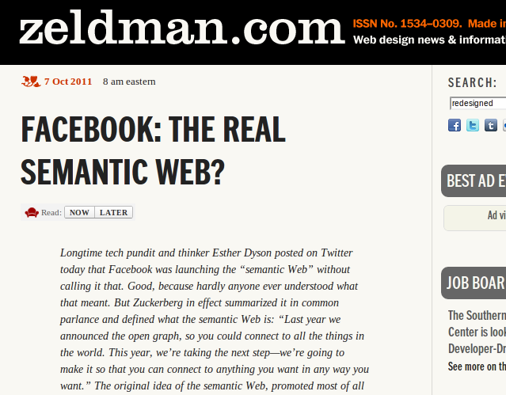
Today...

Slide 14
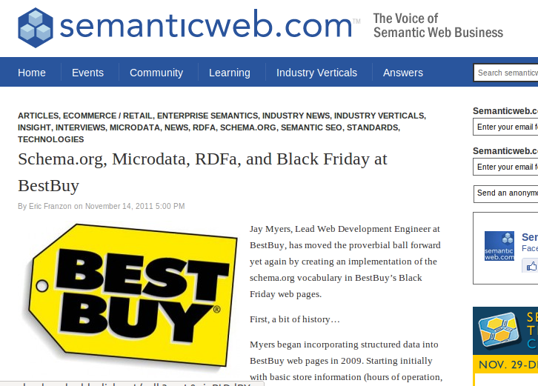
Today...

Slide 15
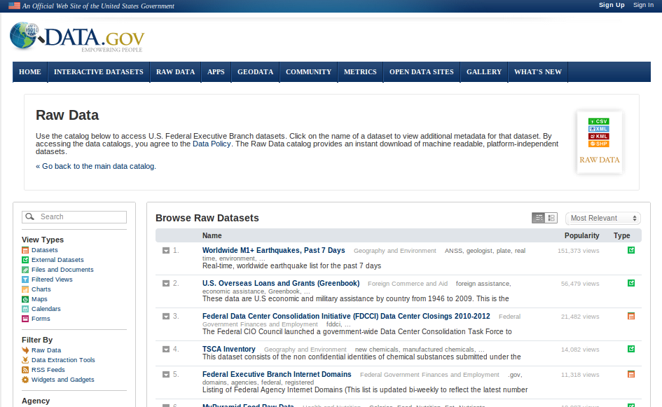
Today...

Slide 16
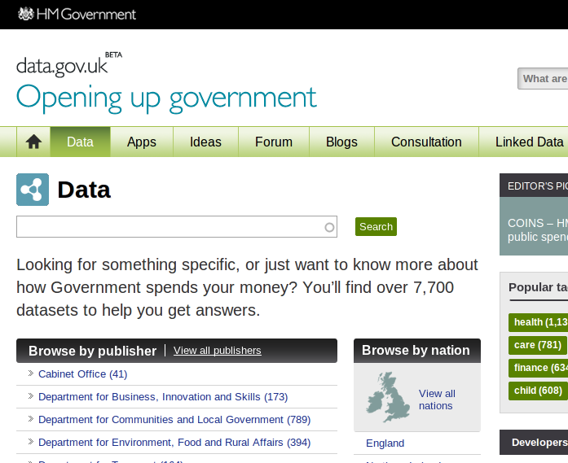
Today...

Slide 17
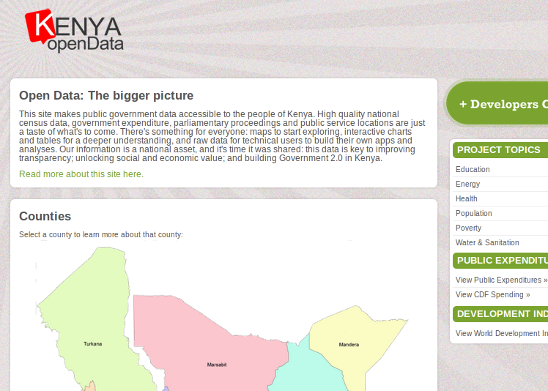
Today...

Slide 18
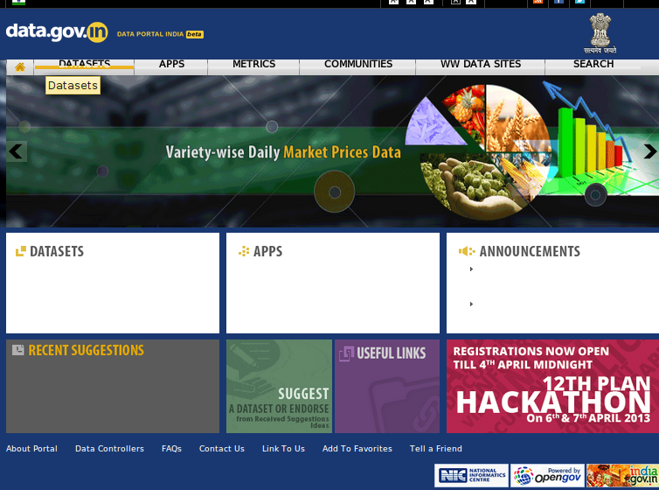
Today...

Slide 19






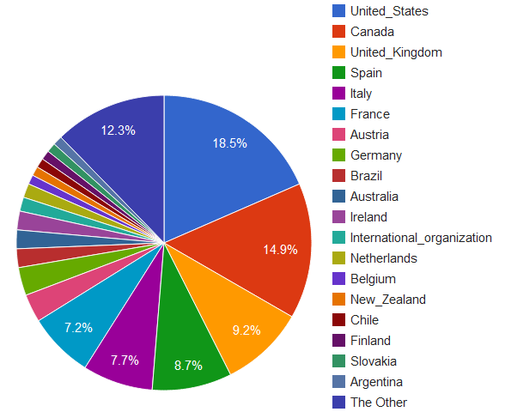




Slide 20
Int'l Open Gov't Dataset Search: searching 1,022,787 datasets from 192 catalogs in 24 languages representing 43 countries and international organizations (Summer 2012)

Slide 21
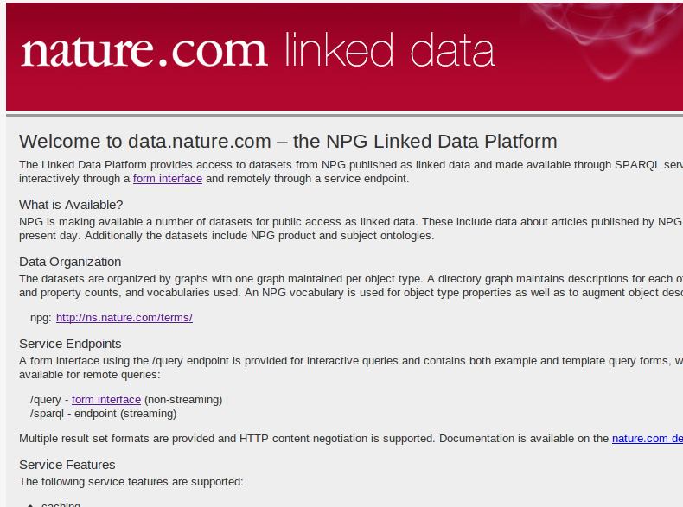
Today...

Slide 22
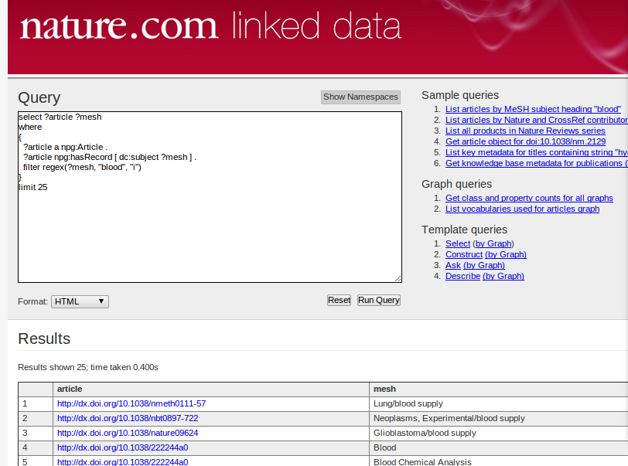
2012...

Slide 23
Semantic Web?

Slide 24
Semantic Web?
“Web of meaning”

Slide 25
Semantic Web?
“Web of meaning”
Make meaningful assertions about things on the Web...
Web of Data

Slide 26
Semantic Web?
“Web of meaning”
Link ideas...
Web of Data
Linked Data

Slide 27
Assertions...

Slide 28
...about ideas???

Slide 29
subject
object

Slide 30
subject
object
article
Jim

Slide 31
doi:10.1109/MC.2009.30
http://purl.org/dc/elements/1.1/creator
http://dbpedia.org/resource/James_Hendler

Slide 32
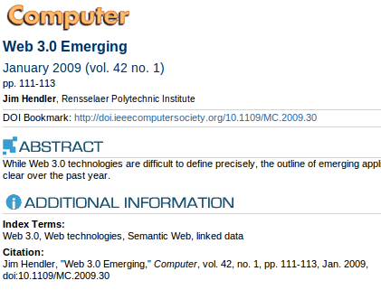
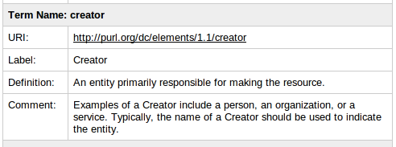
doi:10.1109/MC.2009.30
http://purl.org/dc/elements/1.1/creator
http://dbpedia.org/resource/James_Hendler

Slide 33
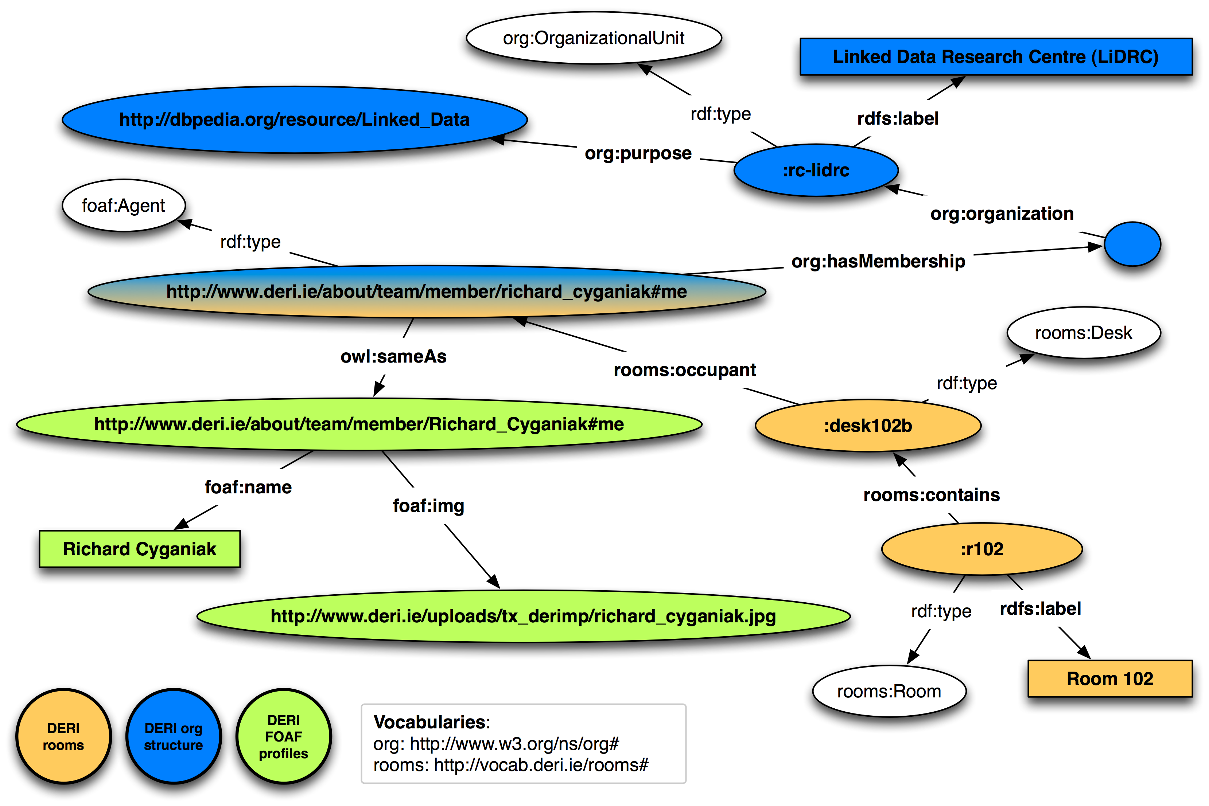

Slide 34
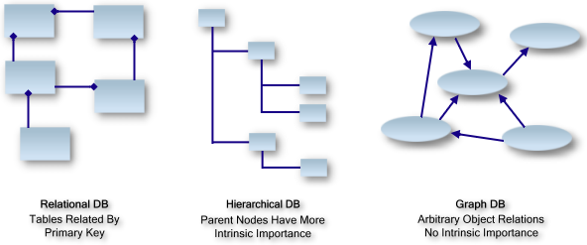
Intro to SPARQL and Graph DB (RDF Triple Stores)

Slide 35
Encoding Knowledge in a Graph
Bengie is a dog.
Bonnie is a cat.
Bengie and Bonnie are friends.

Slide 36
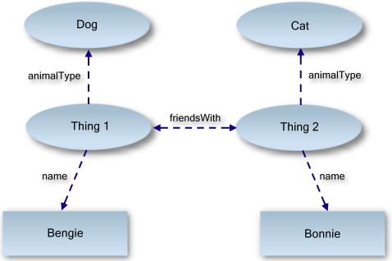
Everything is a Triple

Slide 37
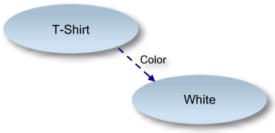
RDF/XML Example
Subject is the T-shirt
Predicate (property) is the color
Object is white

Slide 38
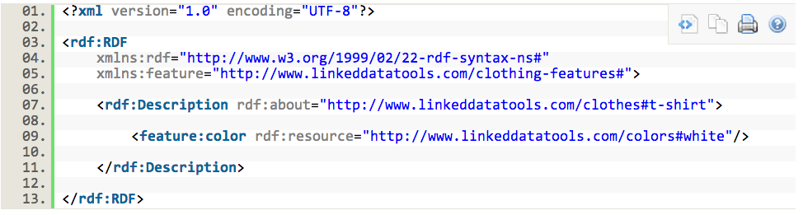
RDF/XML (Encoding RDF Data in XML)

Slide 39
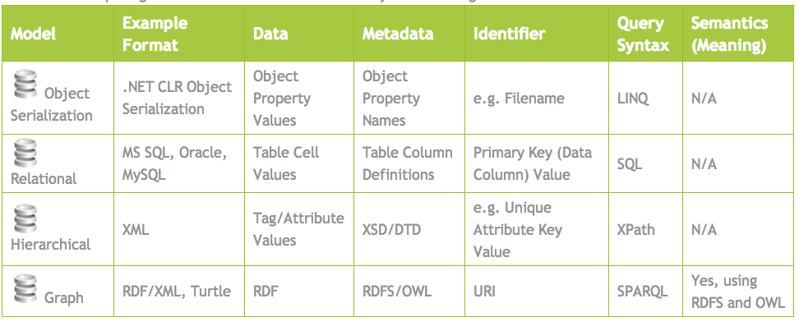

Slide 40
That's how to describe things...

Slide 41
...but how do we find things?

Slide 42

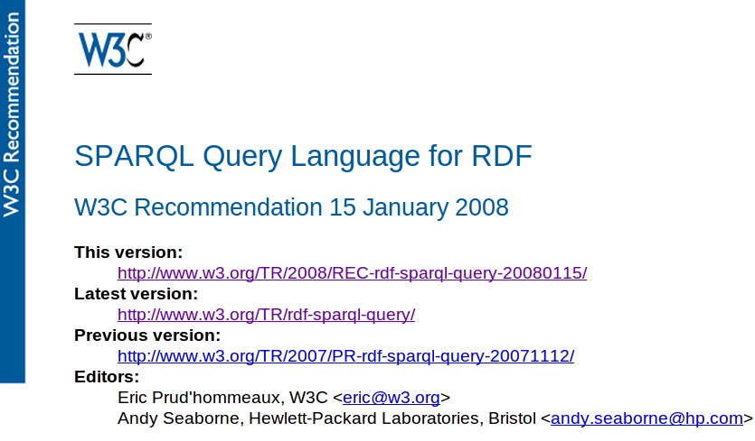
SPARQL:
pattern matching over RDF graphs

Slide 43
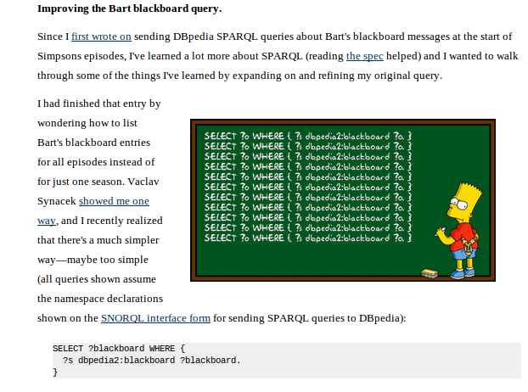
http://bit.ly/RumkhW
?s
?blackboard

Slide 44
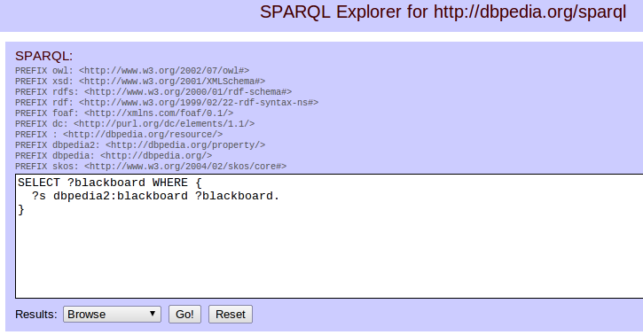
http://bit.ly/Rumtlp
?s
?blackboard

Slide 45
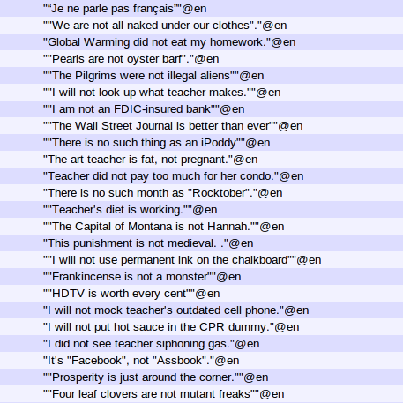

Slide 46
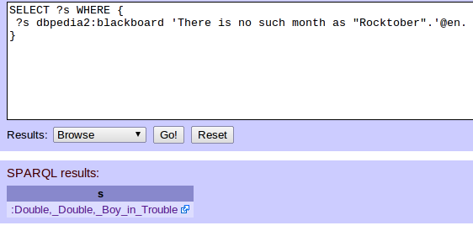
http://bit.ly/RumQwu

Slide 47
http://bit.ly/RumQwu
?s
“There is no such month as “Rocktober”

Slide 48
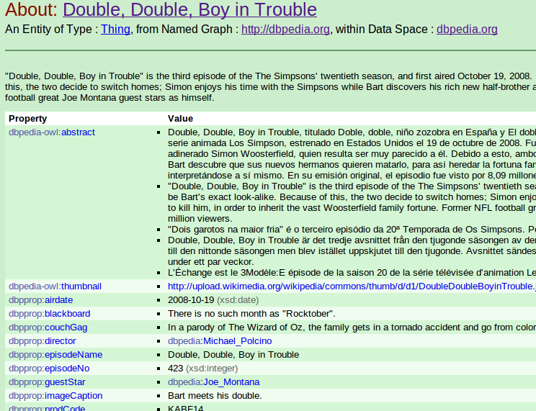
http://bit.ly/RumQwu

Slide 49
http://bit.ly/RumQwu
http://dbpedia.org/resource/Double,_Double,_Boy_in_Trouble

Slide 50
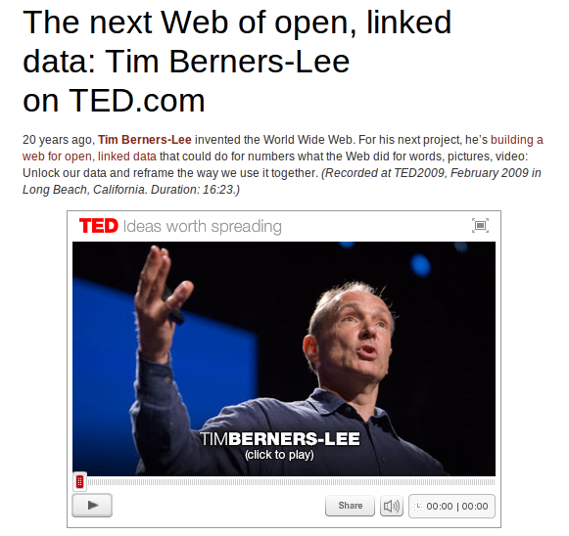

When in 2009 The Inventor said unto us...

Slide 51
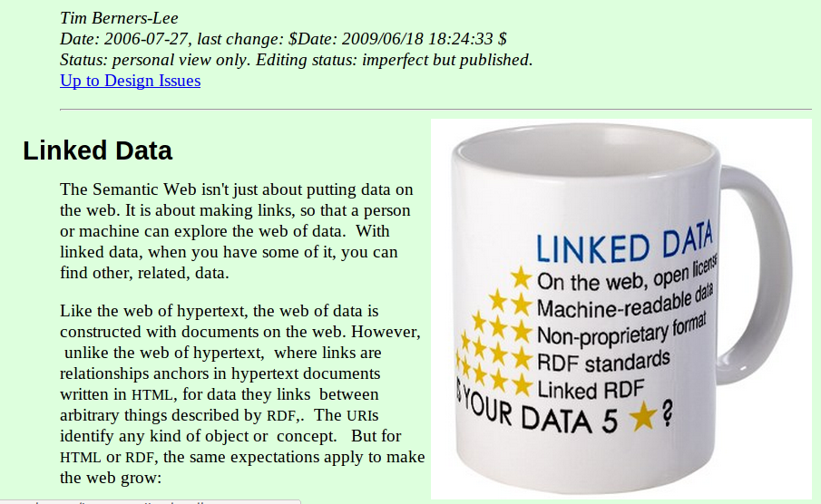

Slide 52
Use URIs as names for things
Use HTTP URIs so that people can look up those names (on the Web)
When someone looks up a URI, return useful information, using the standards (RDF*, SPARQL)
Include links to other URIs, so that they can discover more things

Slide 53

Use URIs as names for things
Use HTTP URIs so that people can look up those names (on the Web)
When someone looks up a URI, return useful information, using the standards (RDF*, SPARQL)
Include links to other URIs, so that they can discover more things

Slide 54
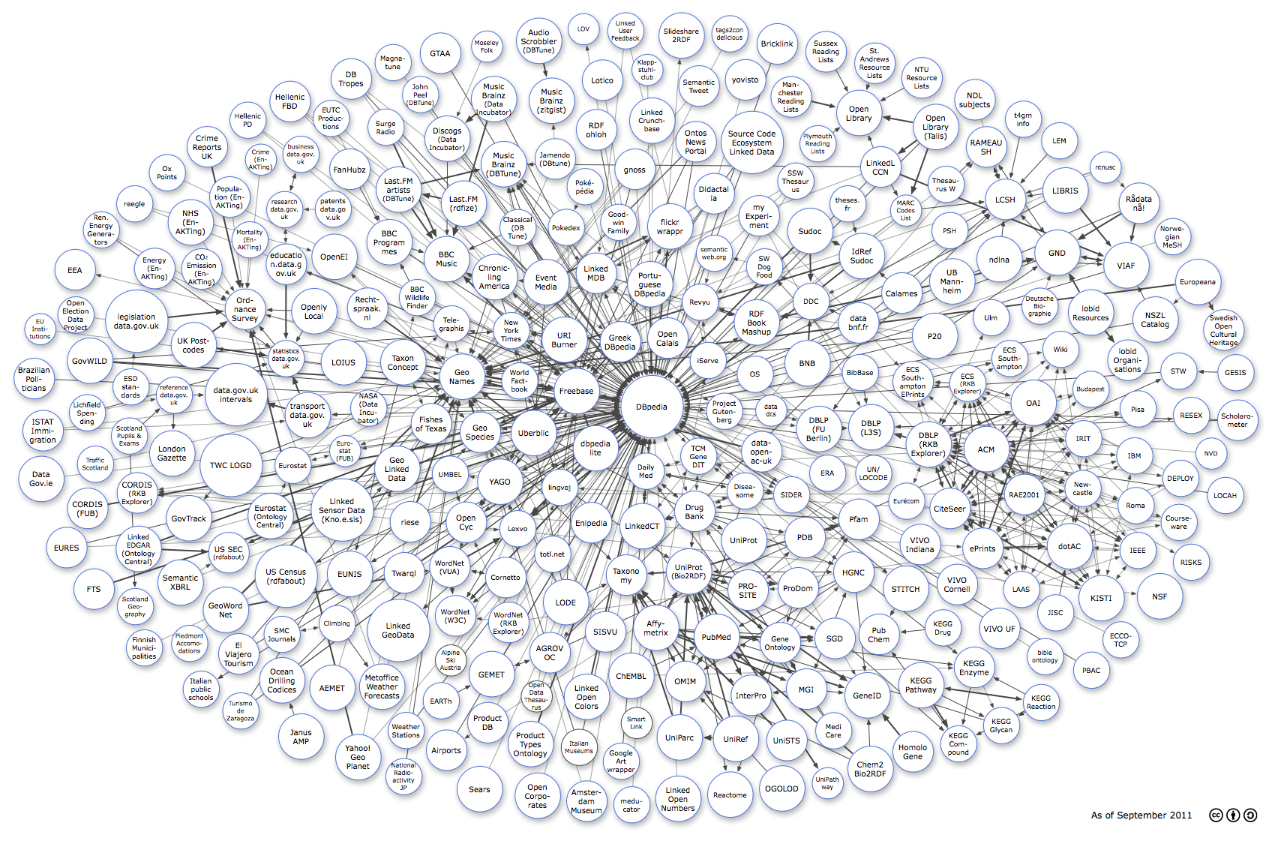
The Linked Data Cloud

Slide 55
The Linked Data Cloud

Slide 56
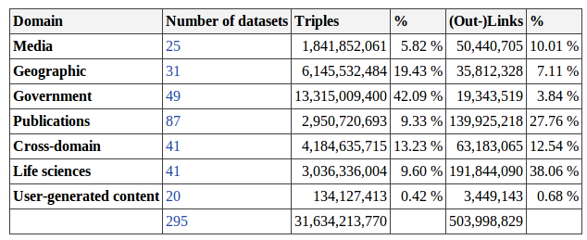
The Linked Data Cloud

Slide 57
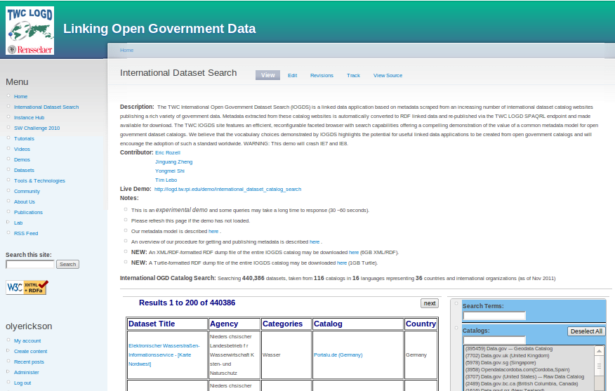
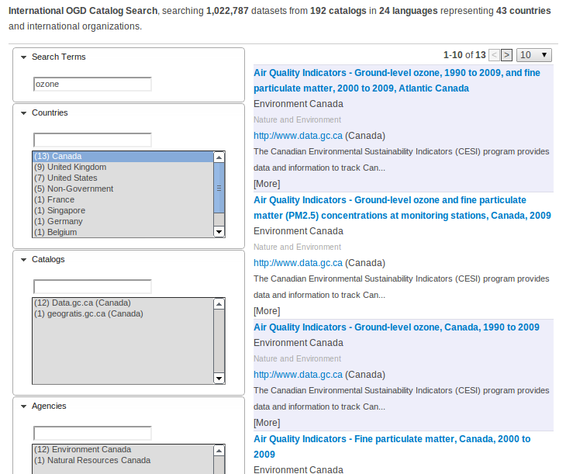

Slide 58
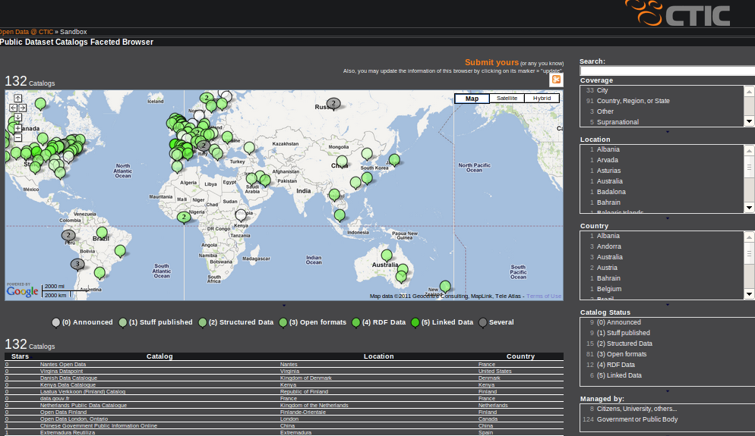

Slide 59
How does this help us?

Slide 60
Linked Data enables agile
data integration
and application creation

Slide 61
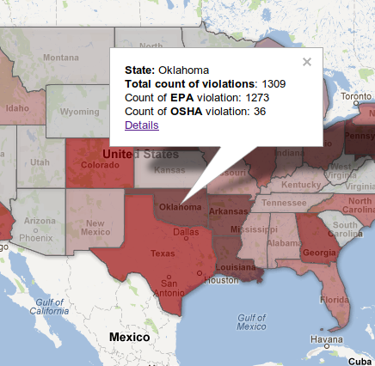
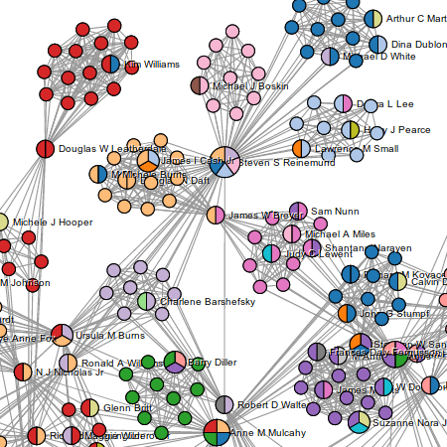
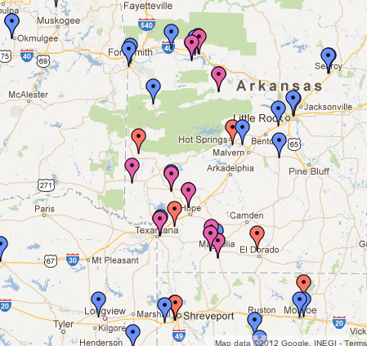
Mashup: OrgPedia Open Corporate Data
http://tw.rpi.edu/orgpedia/

Slide 62
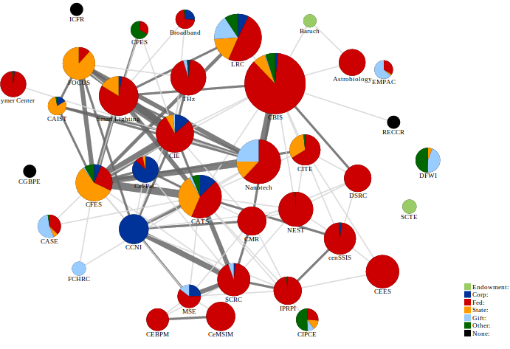
Mashup: RPI Research Centers

Slide 63
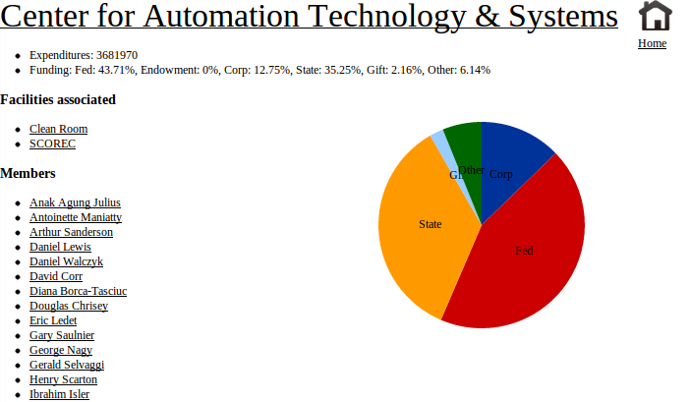
Mashup: RPI Research Centers

Slide 64
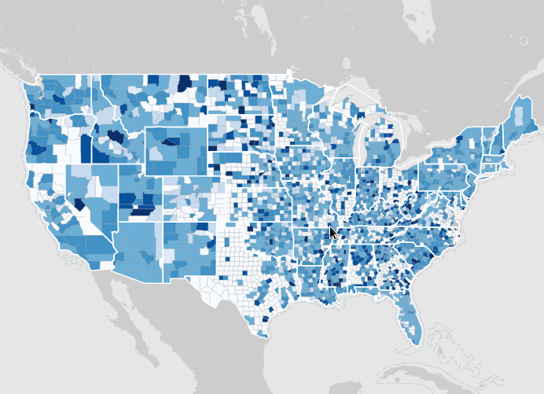
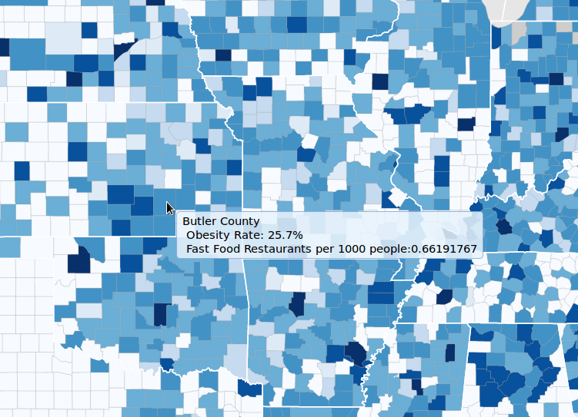
Mashup: Research Data

Slide 65
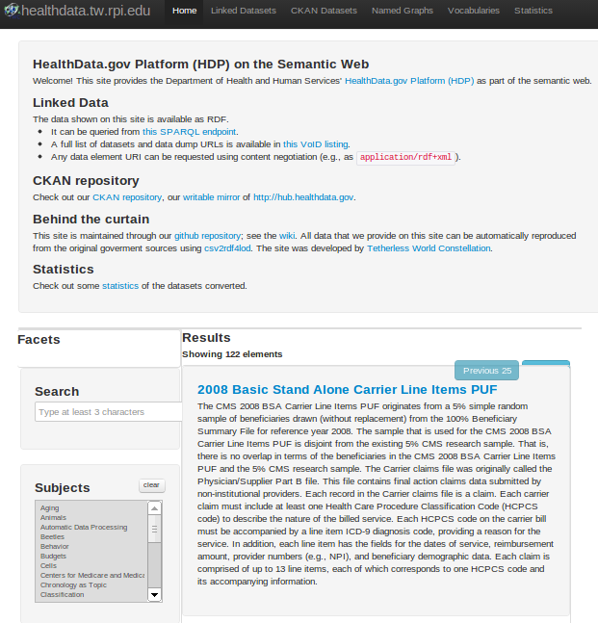
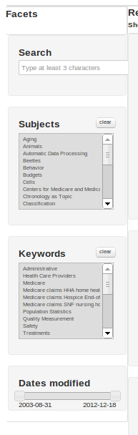
Linked Data Publication: HHS Health Data

Slide 66
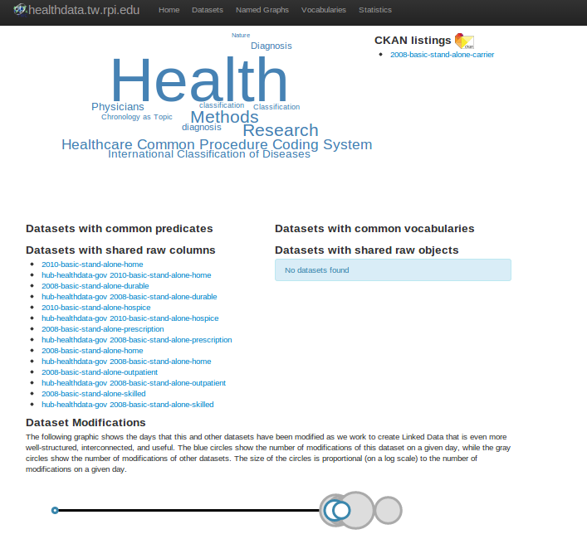
Linked Data Publication: HHS Health Data

Slide 67

Linked Data Publication: HHS Health Data

Slide 68

Linked Data Publication: HHS Health Data

Slide 69


Linked Data Publication: HHS Health Data

Slide 70

Example: Extending a Sci Publishing Portal

Slide 71




Slide 72


Slide 73



Slide 74
[data integration/data science]

Slide 76

[data integration/data science]

Slide 77
...the purpose of the lecture is
to summarize the Semantic Web
with key concepts and
the introduction of a few advanced ideas
that will be useful to these graduating seniors
in grad school
or their careers...

Slide 78
Semantic Web
key concepts...
RDF, SPARQL,
Linked Data,
mashups, dataviz, RDFa, microformats,
Schema.org

Slide 79
Semantic Web
key concepts...
advanced ideas...
RDF, SPARQL,
Linked Data,
mashups, dataviz, RDFa, microformats,
Schema.org
ontology, inference,
reasoning, provenance, machine learning, policy-based systems

Slide 80
Semantic Web
key concepts...
advanced ideas...
RDF, SPARQL,
Linked Data,
mashups, dataviz, RDFa, microformats,
Schema.org
ontology, inference,
reasoning, provenance, machine learning, policy-based systems
careers...

Slide 81


Slide 82


Slide 83


Slide 84


Slide 85


Slide 86


Slide 87


Slide 88


Slide 89

????

Slide 90


Many Thanks for creating this presentation To:
John S. Erickson, Ph.D.
Director, Web Science Operations
Tetherless World Constellation
RPI
John S. Erickson, Ph.D.
Director, Web Science Operations
Tetherless World Constellation
RPI

